Slide 1
Cloud Infrastructure Mechanisms Module – 3 Topic -4
Karthikeyan S

Slide 2
Topics
Network Perimeter - Completed
Virtual Server - Completed
Cloud Storage Device – Completed
Cloud Usage Monitor
Resource Replication.

Slide 3
Cloud Usage Monitor
The cloud usage monitor mechanism is a lightweight and autonomous software program responsible for collecting and processing IT resource usage data.

Slide 4
three common agent-based implementation
Each can be designed to forward collected usage data to a log database for post-processing and reporting purposes.
Monitoring Agent
Resource Agent
Polling Agent

Slide 5
1. Monitoring agent
A monitoring agent is an intermediary, event-driven program that exists as a service agent and resides along existing communication paths to transparently monitor and analyze dataflows.
This type of cloud usage monitor is commonly used to measure network traffic and message metrics.

Slide 6
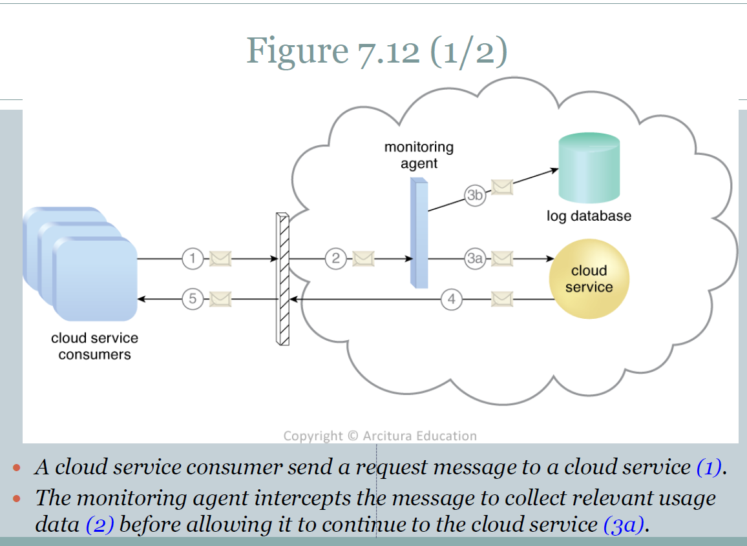

Slide 7
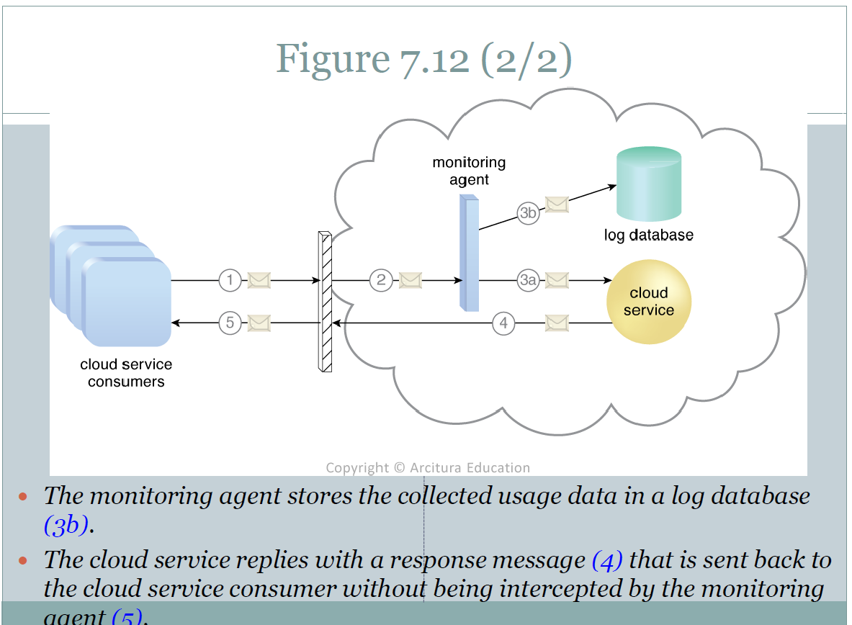

Slide 8
2. Resource agent
A resource agent is a processing module that collects usage data by having event-driven interactions with specialized resource software (Figure 7.13).
This module is used to monitor usage metrics based on pre-defined, observable events at the resource software level, such as initiating, suspending, resuming, and vertical scaling.

Slide 9
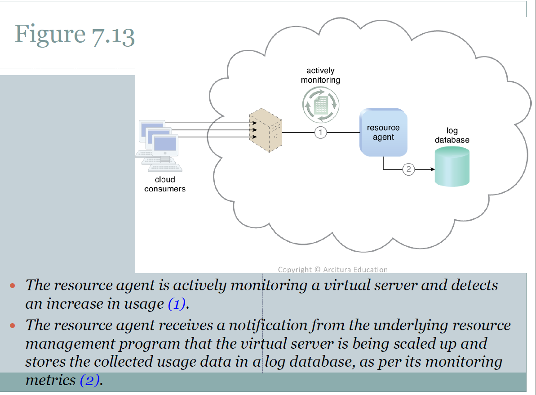

Slide 10
3.Polling Agent
A polling agent is a processing module that collects cloud service usage data by polling IT resources. This type of cloud service monitor is commonly used to periodically monitor IT resource status, such as uptime and downtime.

Slide 11
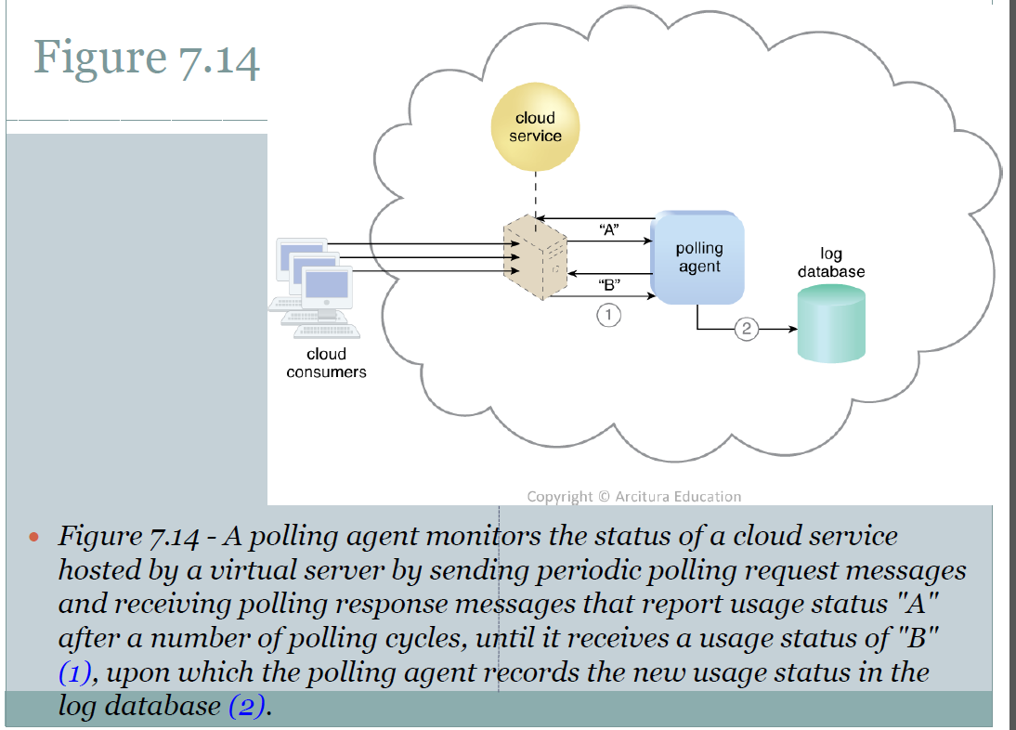

Slide 12
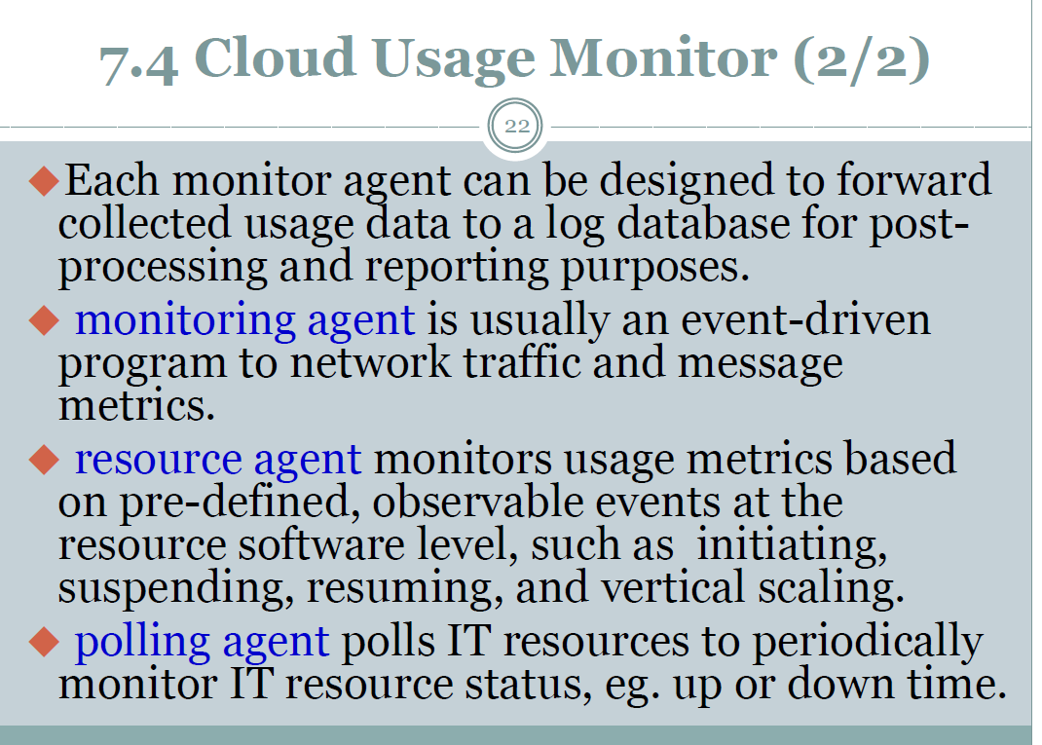
Summary

Slide 13
Next … Resource Replication
Replication is usually performed when resource’s availability and performance need to be enhanced.
Resource Replication mechanism usually uses virtualization technology to replicate cloud-based IT resources.

Slide 14
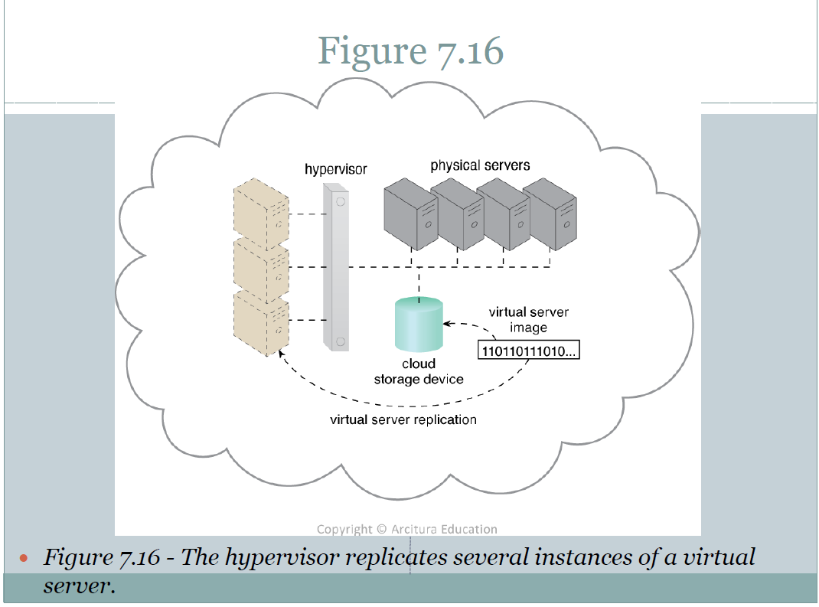

Slide 15
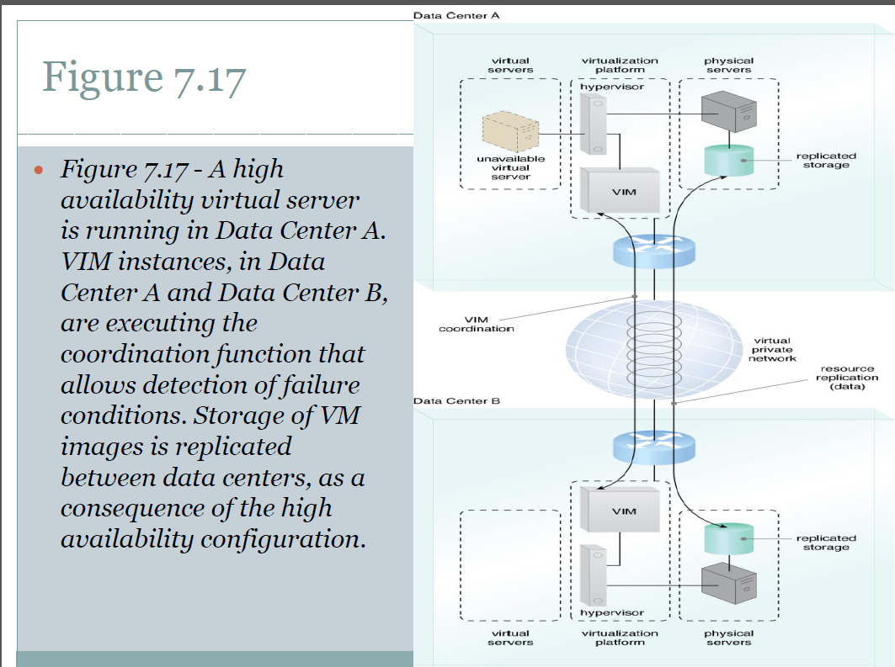

Slide 16
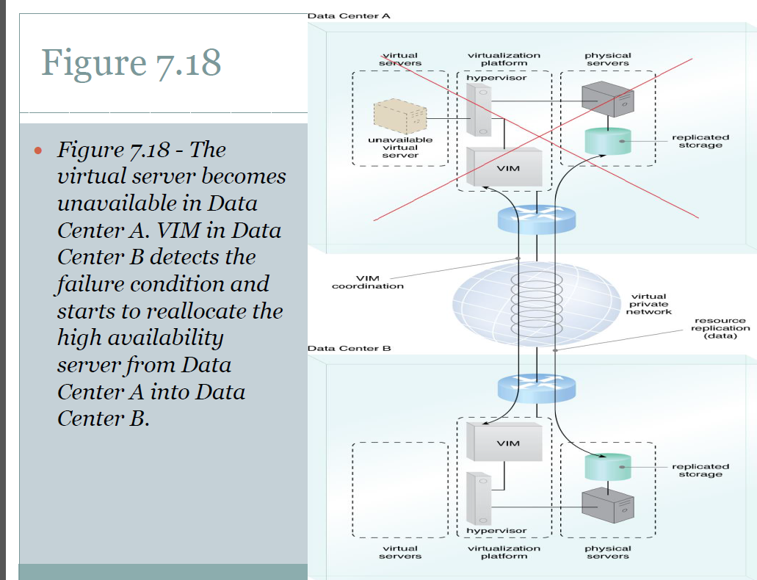

Slide 17
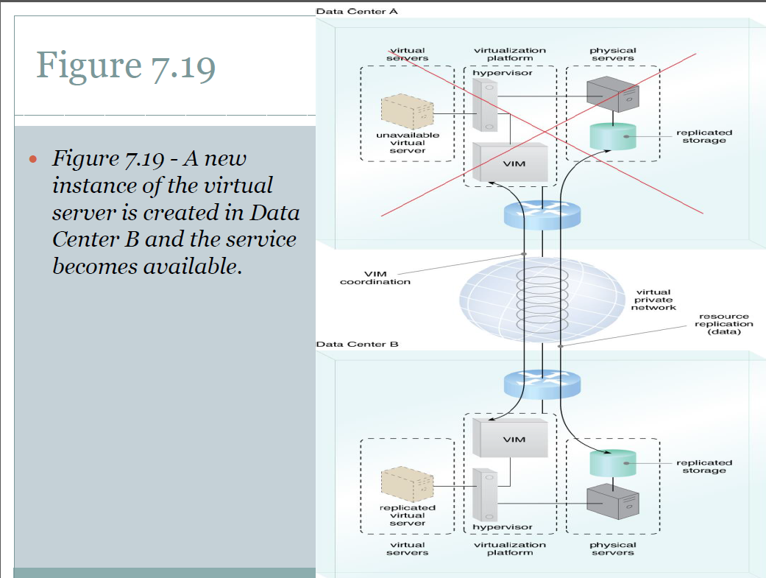

Slide 18
3.Ready-Made Environment
The ready-made environment mechanism is a defining component of the PaaS cloud delivery model that represents a platform comprised of a set of already installed IT resources, ready to be used and customized by a cloud consumer.
Ready-made environments are utilized by cloud consumers to remotely develop and deploy their own services and applications within a cloud by providing with a complete software development kit (SDK).
Typical ready-made environments include pre-installed IT resources, Eg. Database, Middleware, Governance tools.

Slide 19
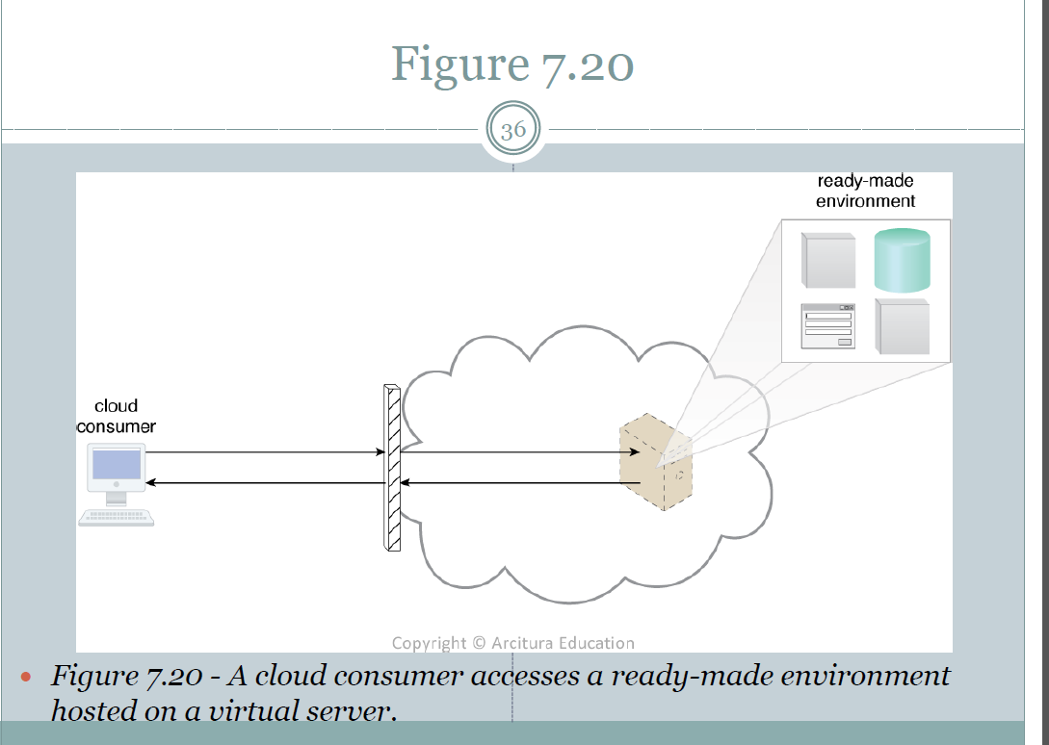

Slide 20
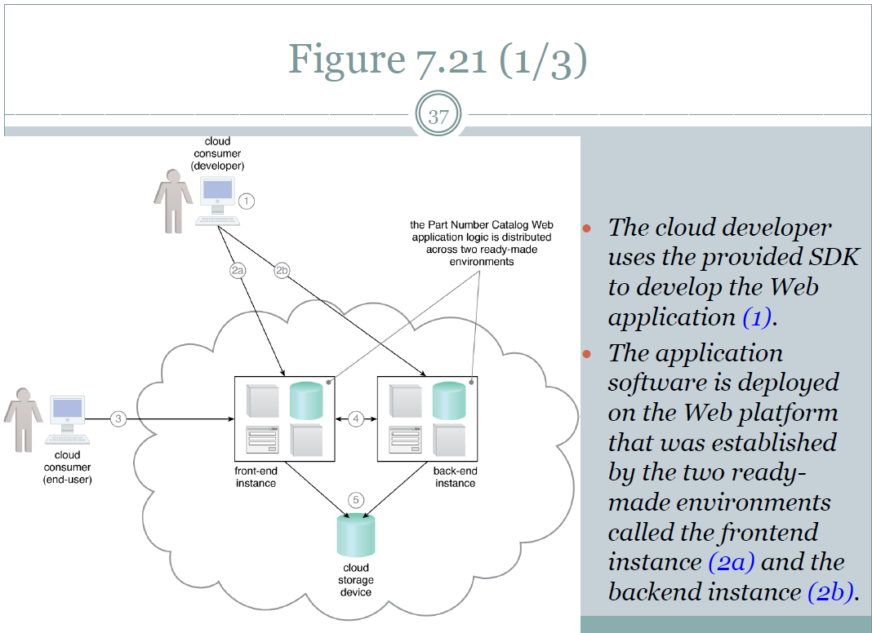

Slide 21
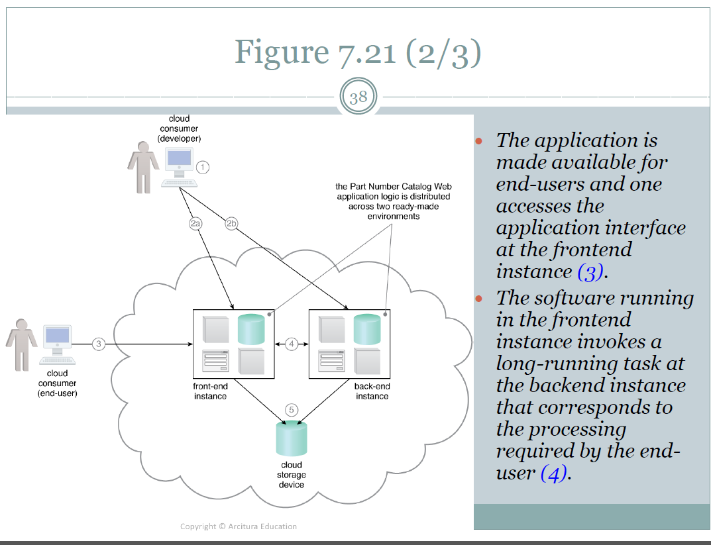

Slide 22
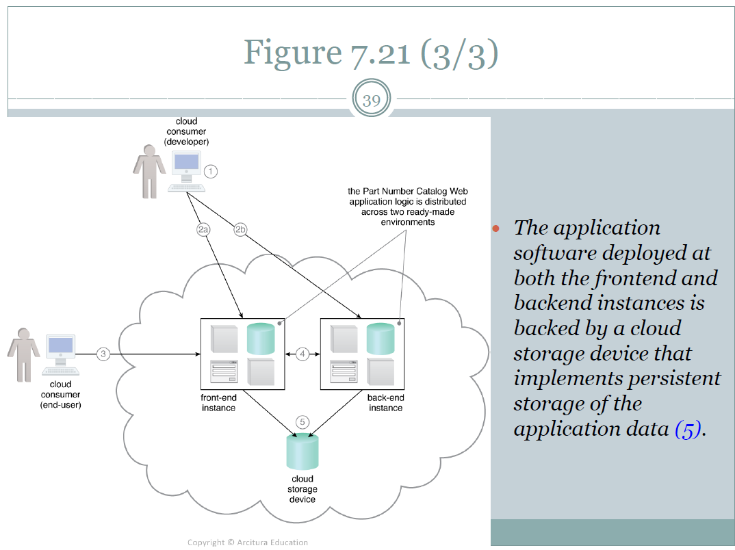

Slide 23
thanks

